Slide 1
Muhammad Musa
Week # 04

Slide 2
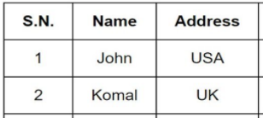
Table Border
You can get a quick border around your table by using the HTML border attribute.
Code; border: 2px solid black;
The border-collapse property sets whether table borders should collapse into a single border.
Code; border-collapse : collapse;

Slide 3
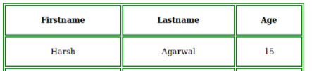
Table Cell Padding
Cell padding specifies the space between the cell content and its borders.
Code; padding : 15px;

Slide 4
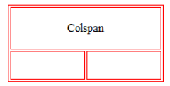
Table Colspan
To make a cell span more than one column, use the colspan attribute.
Code; <th colspan = “3”>

Slide 5
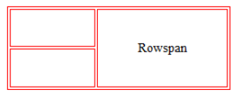
Table Rowspan
To make a cell span more than one row, use the rowspan attribute.
Code; <th rowspan = “3”>

Slide 6
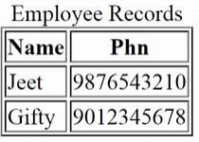
Table <caption> Tag
The <caption> tag defines a table caption.
The <caption> tag must be inserted immediately after the <table> tag.
Code; <caption>Employee Records</caption>

Slide 7
Id Attribute
To define a special style for one particular tag, add an id attribute.
The id attribute specifies a unique id for an HTML element.
Code; #musa { width: 100%; background-color: #f1f1c1; }
<table id=“musa">
<th id=“musa”>

Slide 8
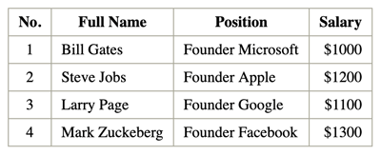
Table Tr
<table> <tr>------</tr> </table>
It is used to create a row within a Table.

Slide 9
Table Th
<tr> <th> ------ </th></tr>
It is used to create a Table Heading within the table’s row.
Table head

Slide 10
Table Td
<tr> <td>------ </td> </tr>
It is used to create a column of data
within the table row.
Table data

Slide 11
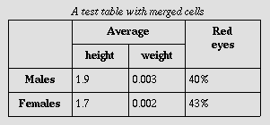
Table Rowspan
<tr> <td rowspan=“2” > ------ </td> </tr>
The rowspan attribute in HTML specifies the number of rows a cell should span.
Rowspan used

Slide 12
Table Colspan
<tr> <td colspan=“2”>------</td> </tr>
The colspan attribute in HTML specifies the number of columns a cell should span.
colspan used

Slide 13

Iframe
<iframe src=“---link---“ height="200" width="300" ></iframe>
The ” iframe ” tag defines a rectangular region within the document in which the browser can display a separate document, including scrollbars and borders.

Slide 14
Meta
<meta>-------</meta>
The <meta> tag in HTML provides information about HTML Document or in simple words, it provides important information about a document.It is not visible in the website.

Slide 15
Meta Description
<meta name="description" content=“--------">
The meta description tag in HTML is the 160 character snippet used to summarize a web page's content.

Slide 16
Meta Keywords
<meta name="keywords" content=“---,---,---">
The meta keywords tag is one of several of meta tags that you can insert into your web pages to provide search engines with information about your pages that isn't visible on the page itself.

Slide 17
Meta Keywords
<meta name="keywords" content=“---,---,---">
The meta keywords tag is one of several of meta tags that you can insert into your web pages to provide search engines with information about your pages that isn't visible on the page itself.

Slide 18
Meta Charset UTF-8
<meta charset="UTF-8">
The charset attribute specifies the character encoding for the HTML document.

Slide 19
Meta Viewport
<meta name="viewport" content="width=device-width, initial-scale=1.0">
Without a viewport meta tag, mobile devices render pages at typical desktop screen widths and then scale the pages down, making them difficult to read.

Slide 20
Meta Refresh
<meta http-equiv="refresh" content="5">
Meta refresh is a method of instructing a web browser to automatically refresh the current web page or frame after a given time interval,

Slide 21

Pre Tag
<pre>------</pre>
It is used to display text as it is.

Slide 22
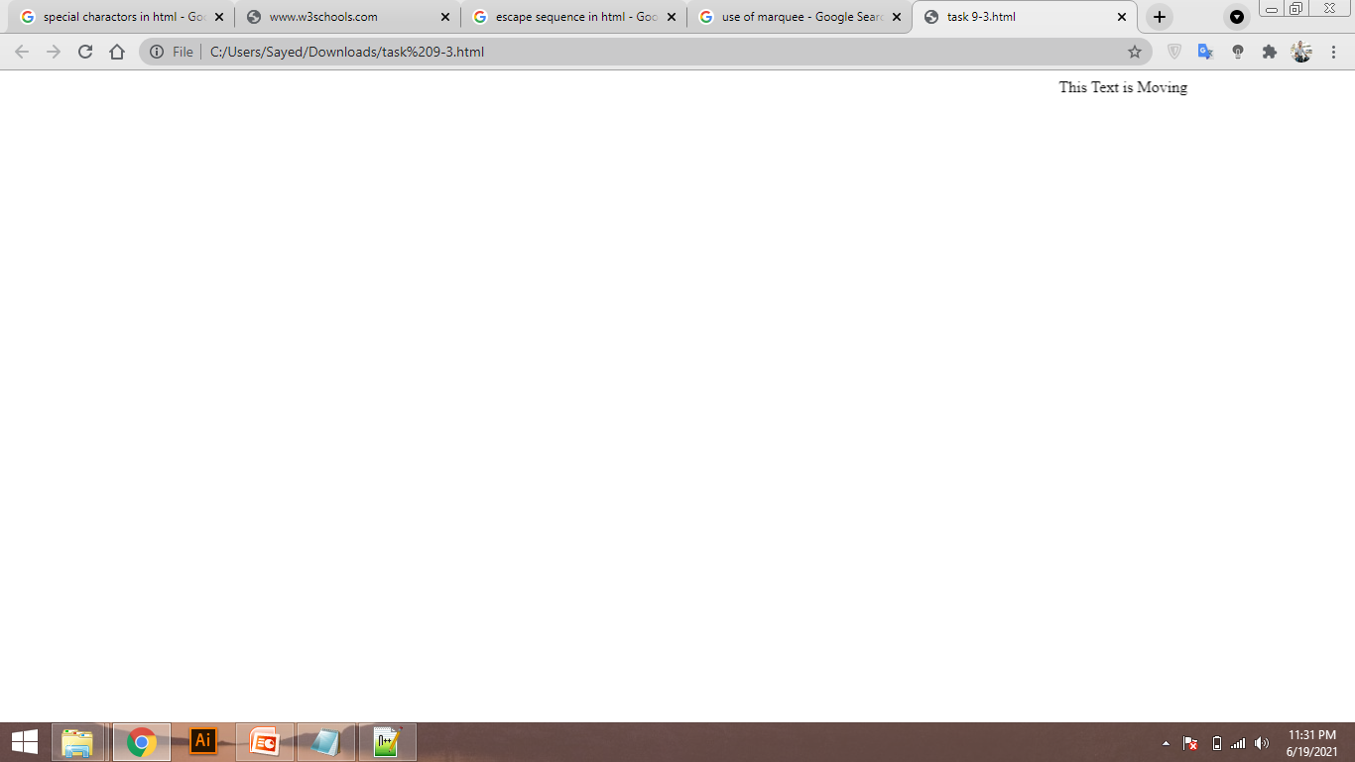
marquee Tag
<marquee> ------ </marquee>
The <marquee> HTML element is used to insert a scrolling area of text. You can control what happens when the text reaches the edges of its content area using its attributes.

Slide 23
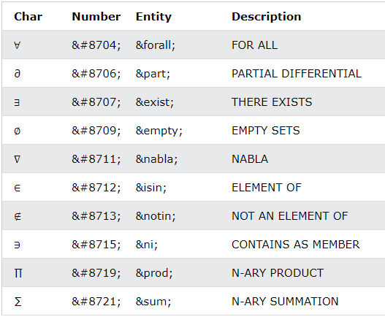
Special Characters
Symbols that are not present on your keyboard can also be added by using entities.

Slide 24
Escape Sequence
&amp creates &
&lt creates <
&gt creates >
&quot creates "
&apos creates '
You can use a character escape to represent any Unicode character in HTML

Slide 25
Form
<form>------ </form>
The HTML <form> tag is used for creating a form for user input. A form can contain textfields, checkboxes, radio-buttons and more.

Slide 26
Label
<label for="name"> Name </label>
The <label> tag in HTML is used to provide a usability improvement for mouse users

Slide 27
Input
<input type=“----" id=“----" name=“----" value=“-----">
The <input> HTML element is used to create interactive controls for web-based forms in order to accept data from the user.

Slide 28

Textbox
<input type="text" id=“----" name=“----" value=“-----">
Text input type is used to get data from user in form of text.

Slide 29
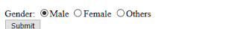
Radio Button
<input type="radio" name=“---" value=“----">"
The HTML <Radio> button is used to define the small circles, which are highlighted when selected. It is a form element which allows the users to select only one option from the given set of options.

Slide 30
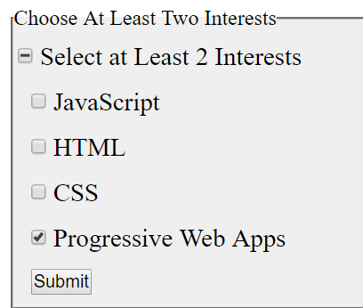
Checkbox
<input type="checkbox" id=“----" name="----" value=“----">
The HTML <checkbox> tag is used to define the square boxes. It is a form element which allows users to select one or more options from the given options.

Slide 31

Drop Down
<select name=“---" id=“---”> <option value="Choose"> Choose </option> </select>
It creates a Drop down list.

Slide 32

Button
<input type=“submit” value=“----”>
It is used to create a Button.

